Slide 1
MICROSERVICE IMPLEMENTATION: TOOLS, PATTERNS & PRACTICES
Halil İbrahim Kalkan

Slide 2


ABOUT ME Halil İbrahim Kalkan
Co Founder
Web: halilibrahimkalkan.com
Github: @hikalkan
Twitter: @hibrahimkalkan

Slide 3
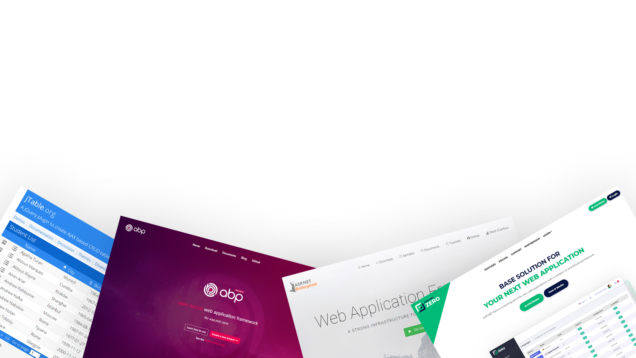
WE ARE DEVELOPING OPEN SOURCE AND COMMERCIAL SOFTWARE DEVELOPMENT TOOLS
FROM DEVELOPERS,TO DEVELOPERS!

Slide 4
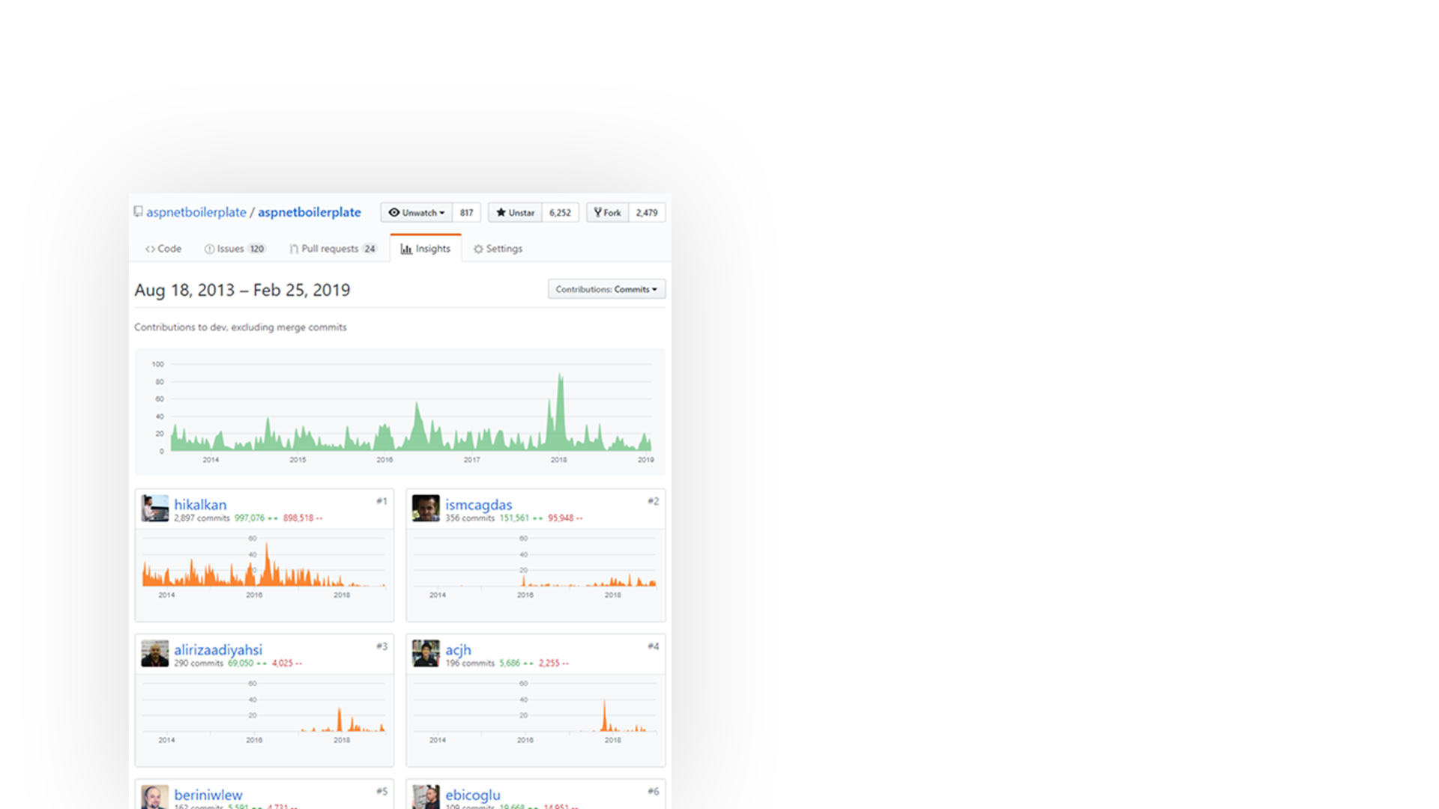
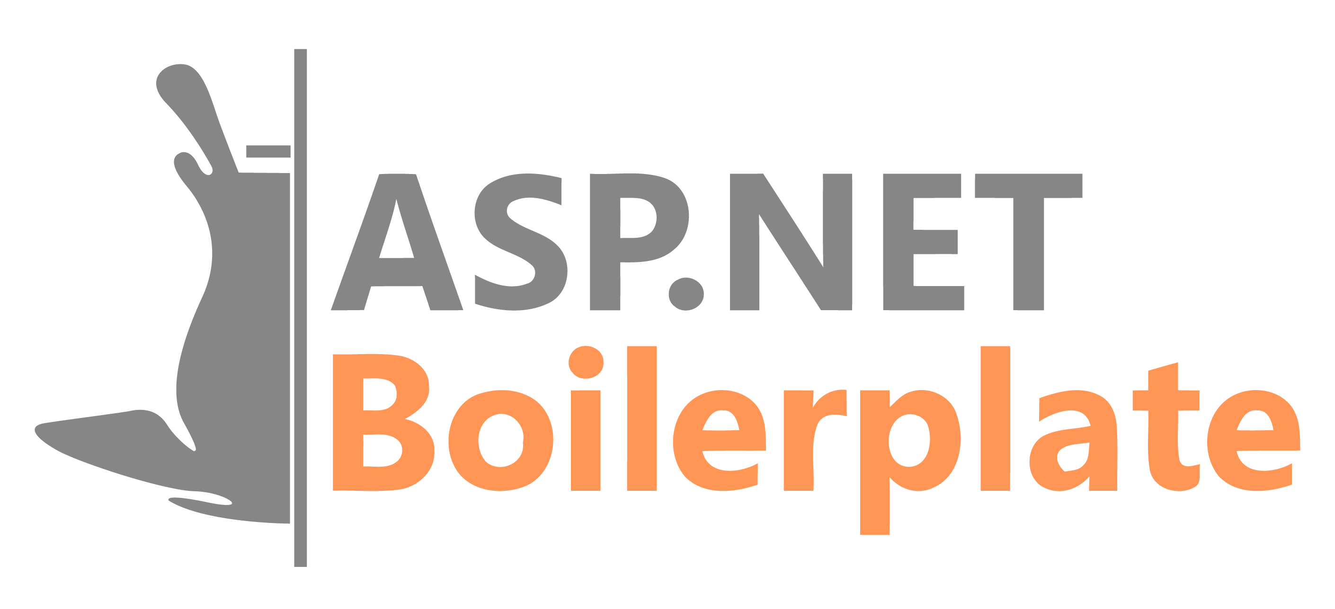
ASP.NET BOILERPLATE
6.000+ stars on GitHub
1.000.000+ downloads on Nuget
https://aspnetboilerplate.com

Slide 5
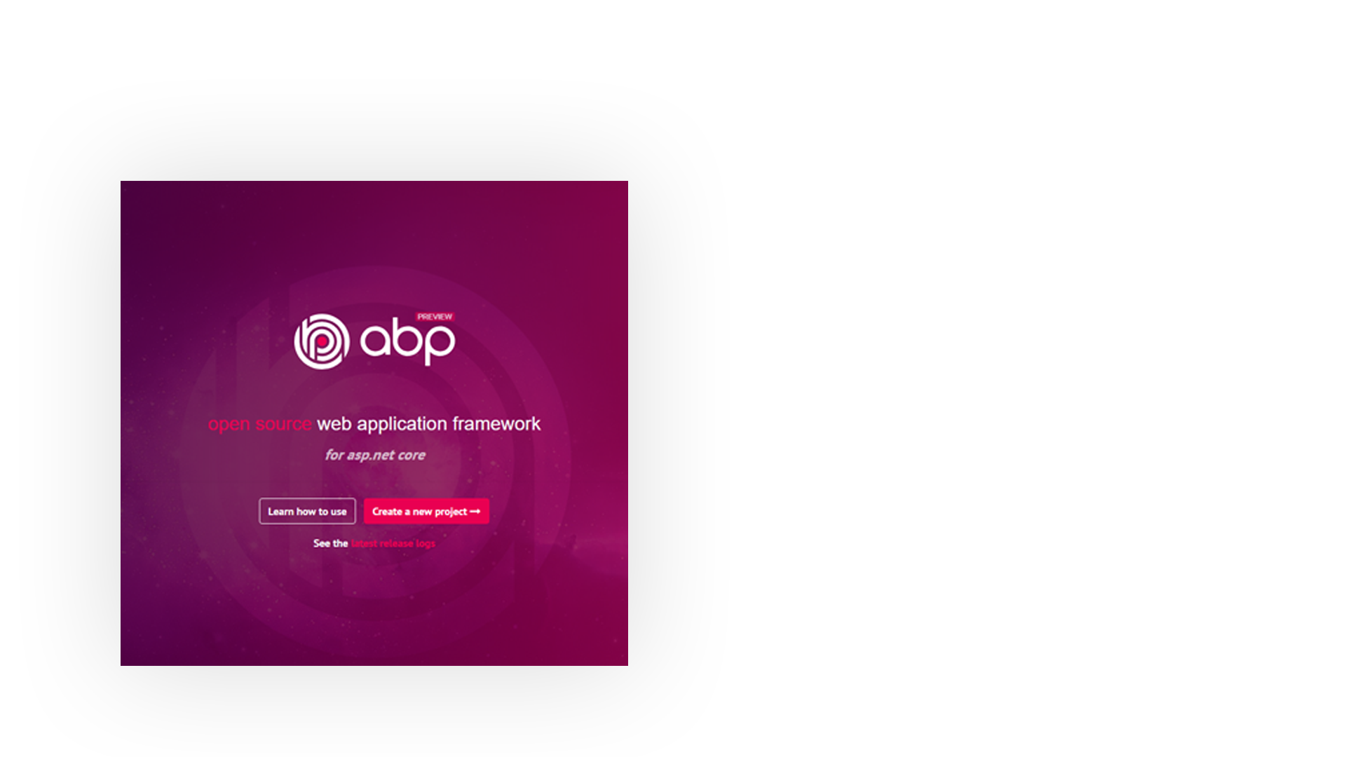
ABP vNEXT
Microservice focused
Modular & extensible architecture
Some Features
Domain Driven Design
Multi-Tenancy
Virtual File System
Dynamic Forms & Tag Helpers
Theming
Background jobs
Dynamic HTTP Client Proxies
Database Agnostic
…
Visit https://abp.io for more

Slide 6

AGENDA
PART - I
PART - II
FROM MONOLITHIC TO MICROSERVICE: CHALLENGES OF THE DISTRIBUTED ARCHITECTURE
THE IMPLEMENTATION

Slide 7
PART – I FROM MONOLITHIC TO MICROSERVICE CHALLENGES OF THE DISTRIBUTED ARCHITECTURE

Slide 8
PART – I : FROM MONOLITHIC TO MICROSERVICE Simple Monolithic Application
Monolithic Application
(UI, APIs, Services, DTOs, Entities, Repositories…)
Single programming language/platform
Dependency Injection & simple method calls.
Easy to create database transaction scopes.
In-process & transactional messaging/event bus.
Single Database

Slide 9
PART – I : FROM MONOLITHIC TO MICROSERVICE Layered Monolithic Application
Organize codebase better by layering
Domain Driven Design (DDD) layers:
Domain Layer
Application Layer
Presentation Layer
Infrastructure Layer
Infrastructure
Layer
Presentation Layer
Application Layer
Domain Layer
Single Database

Slide 10
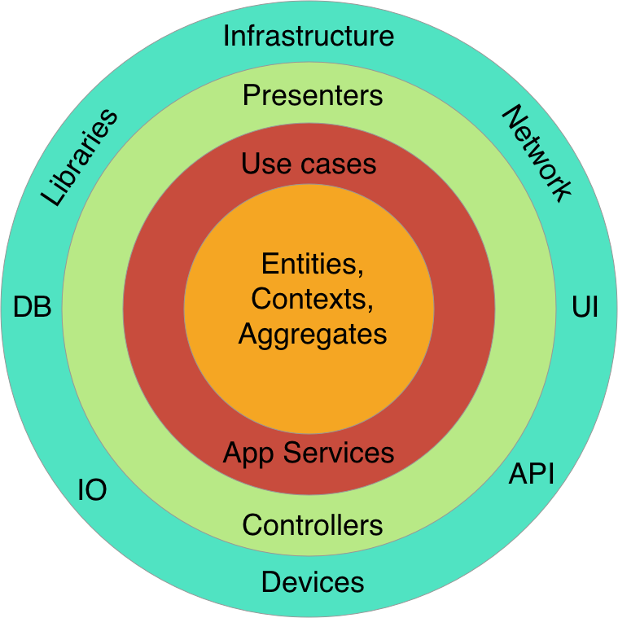
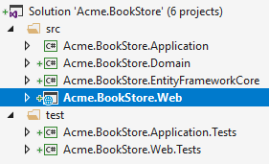
PART – I : FROM MONOLITHIC TO MICROSERVICE Layered Monolithic Application
Clean Architecture / Onion Architecture
Each layer can only depend on the layer directly inside it
More organized, maintainable, reusable & testable code base.
Each layer can be a separated project (csproj file)

Slide 11
PART – I : FROM MONOLITHIC TO MICROSERVICE Modular Application
Each module corresponds to a bounded context in DDD
Modules can have a separated VS solutions
Modules can cross-reference to each other
A module can be layered inside it
Modular in development, but still monolithic on runtime
Monolithic Application
Module - 1
Module - 2
Module - 3
Module - 4
Module - 5
Module - 6
Single Database

Slide 12
PART – I : FROM MONOLITHIC TO MICROSERVICE Modular Application / Separated Databases
Monolithic Application
Database 1
Module - 1
Module - 2
Database 2
Database 1
Module - 3
Module - 4
Database 5
Database 1
Module - 5
Module - 6

Slide 13
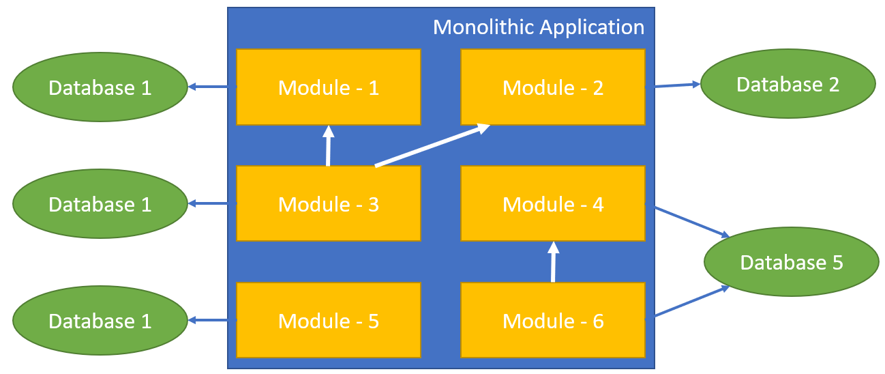
PART – I : FROM MONOLITHIC TO MICROSERVICE Modular Application / Separated Databases
Benefits
Better Scalability
Each database gets less load
Each database can be scaled independently
Schema Changes only affects the related module
Challenges
Cross-database joins is hard or impossible
Inter-module method calls
Data duplication / denormalization
Summary tables
Requires distributed transactions
But not supported by all database systems.

Slide 14
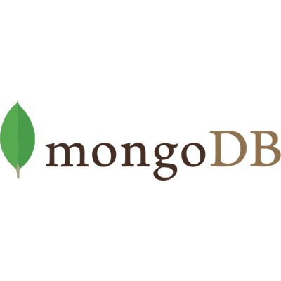

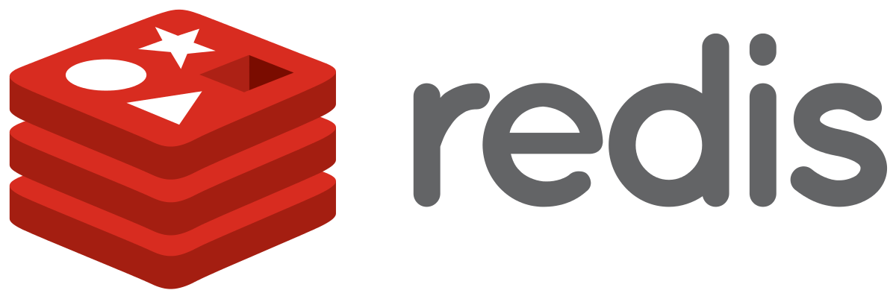
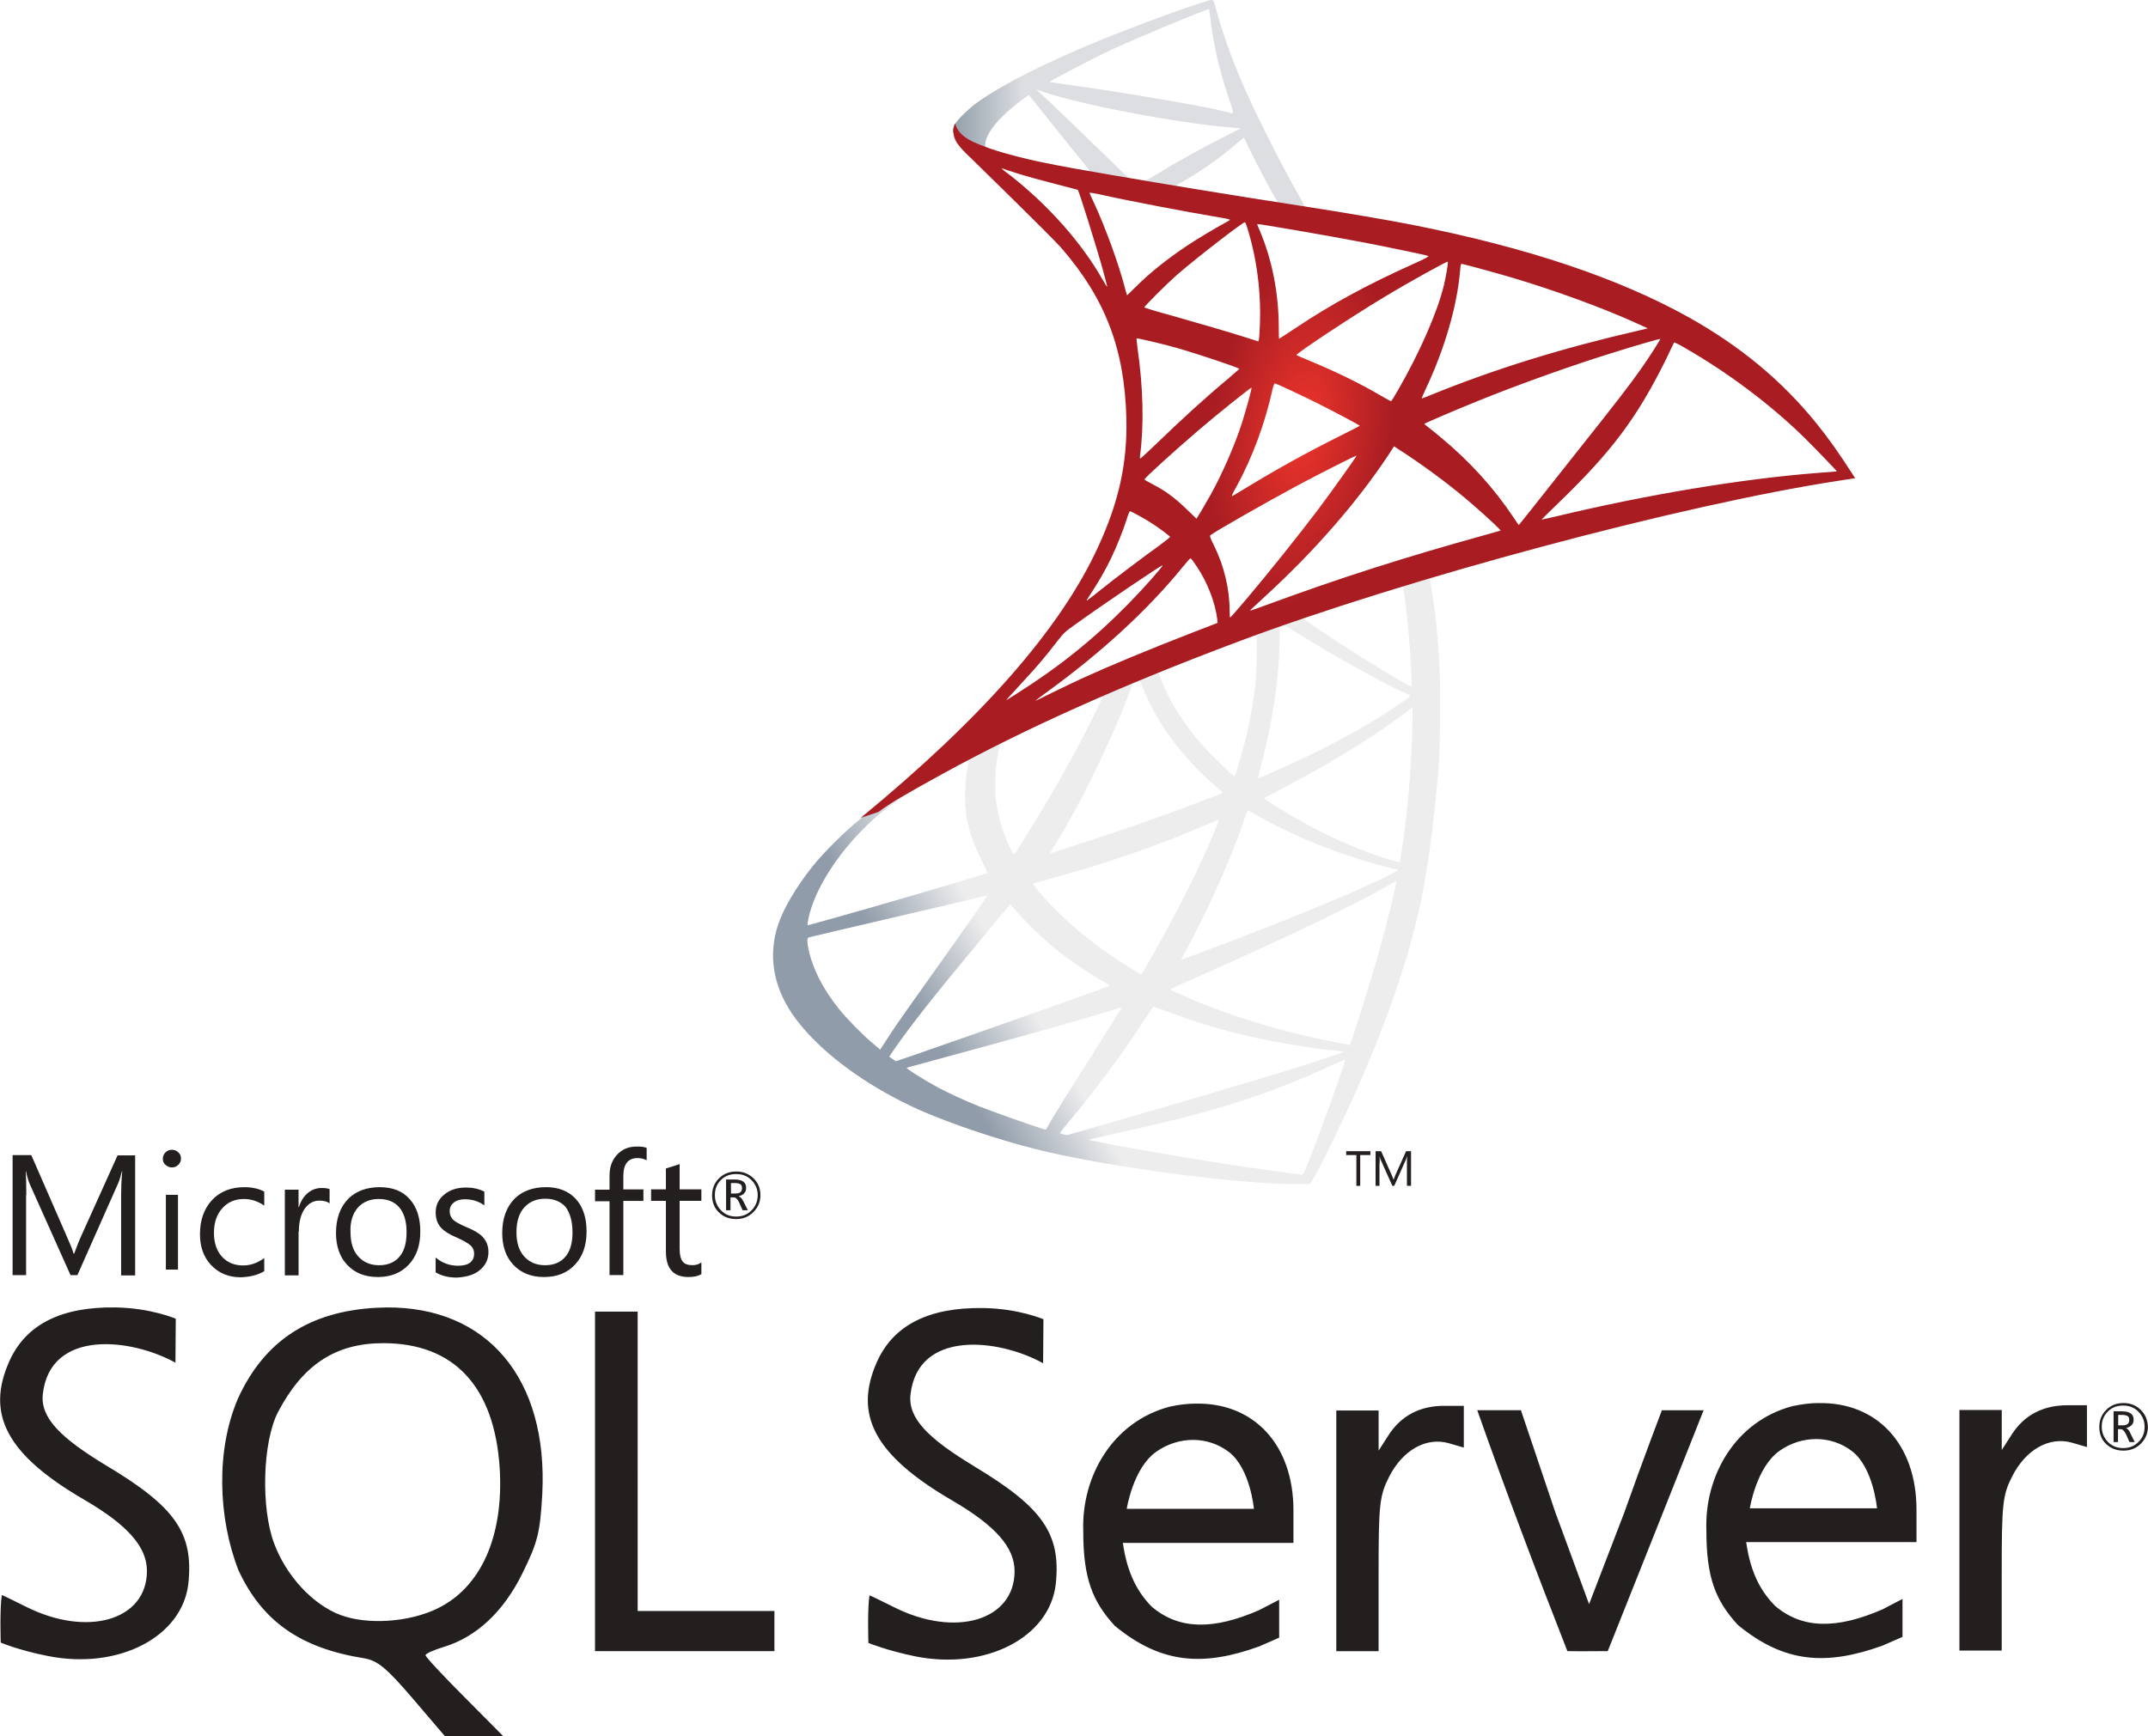
PART – I : FROM MONOLITHIC TO MICROSERVICE Modular Application / Polyglot Persistence
Monolithic Application
Module - 1
Module - 2
Module - 3
Module - 4
Module - 5
Module - 6

Slide 15
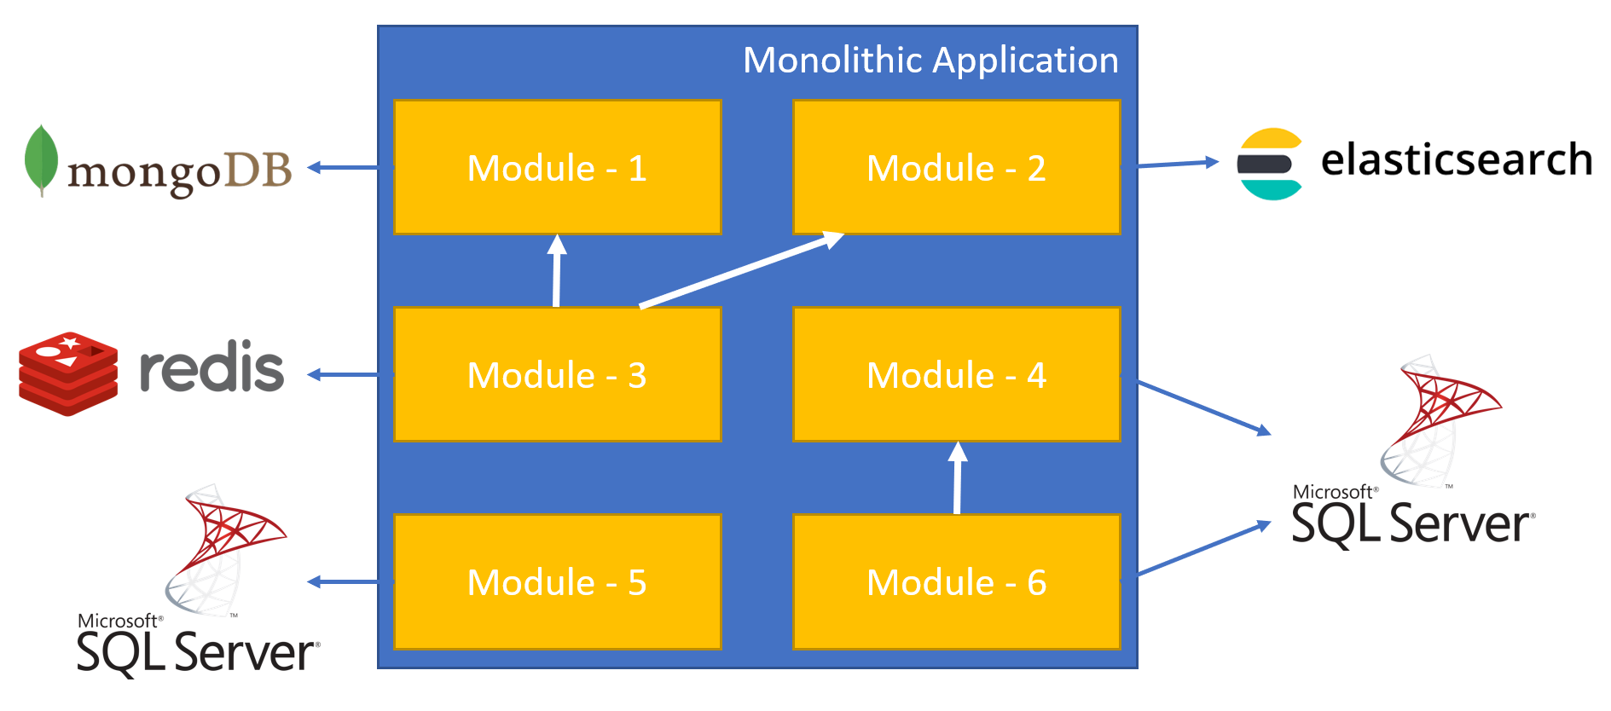
PART – I : FROM MONOLITHIC TO MICROSERVICE Modular Application / Separated Databases
Benefits
A module can use the best DBMS for it.
Challenges
Impossible to have cross-database joins and transactions

Slide 16
PART – I : FROM MONOLITHIC TO MICROSERVICE Distributed Services (SOA)
Web Application
3rd-Party Clients
server/container
server/container
Service - 1
Service - 3
server/container
Service - 2
interprocess communication
interprocess communication

Slide 17
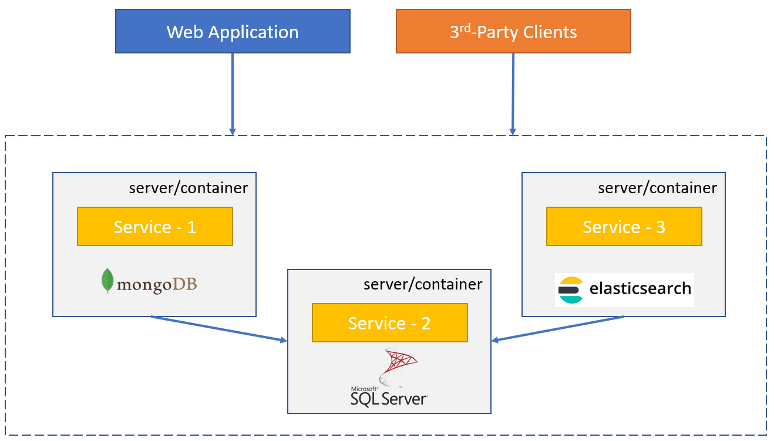
PART – I : FROM MONOLITHIC TO MICROSERVICE Modular Application / Distributed Services (SOA)
Benefits
Better Scalability
Each service gets less load
Each service can be scaled independently
A service can be separately developed, versioned and deployed.
Every service can be developed using a different technology/platform/language as long as they use standard communication protocols (like TCP sockets, REST or GraphQL).

Slide 18
PART – I : FROM MONOLITHIC TO MICROSERVICE Modular Application / Distributed Services (SOA)
Challenges
Complexity of service-to-service communication
Network delays
Security
Service downs
Bottlenecks
Multiple endpoints for clients
Centralized logging/tracing/monitoring
Code share may not be possible if you use different platforms (PHP, Java, Dotnet…)

Slide 19
PART – II THE IMPLEMENTATION

Slide 20
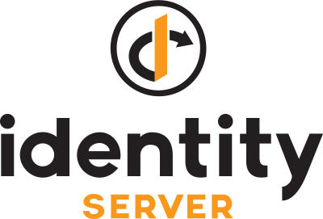
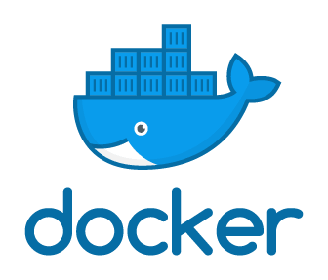




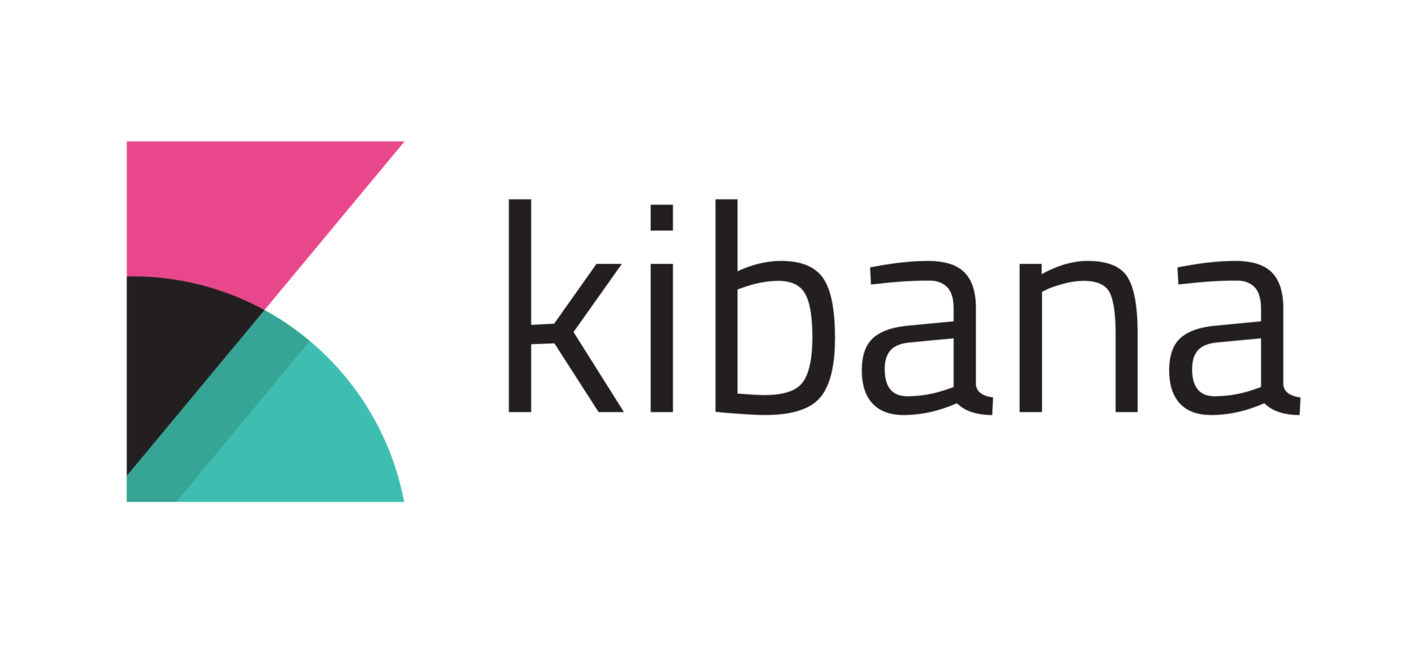
PART – II : THE IMPLEMENTATION Overall Solution
Authentication Server
Identity Microservice
Backend Admin Application (MVC)
Backend App
Gateway
Internal
Gateway
Blogging Microservice
Public Web Site
(MVC)
Public Web Site
Gateway
Event Bus
Product Microservice
RabbitMQ
(Distributed Cache)
(Log Database)
(Data Visualization)

Slide 21
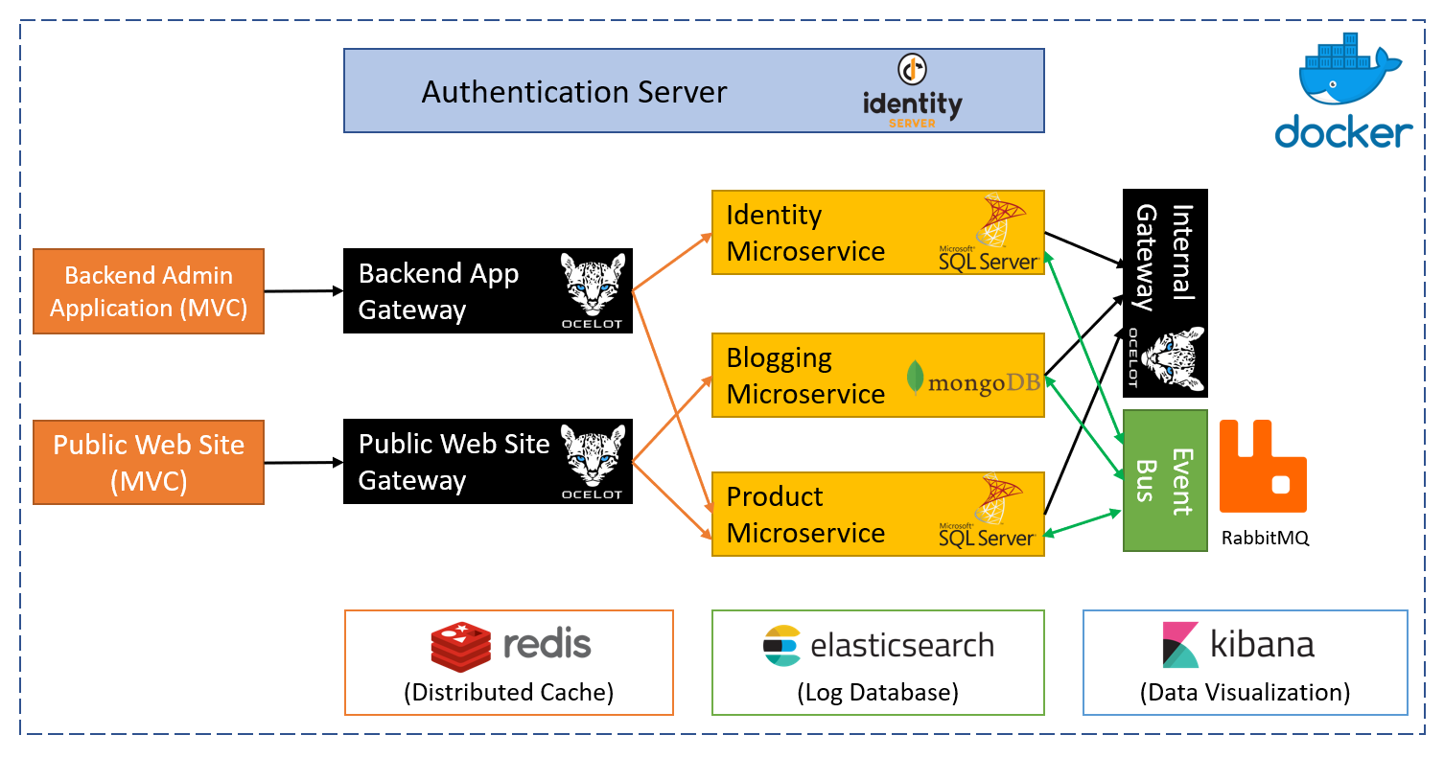
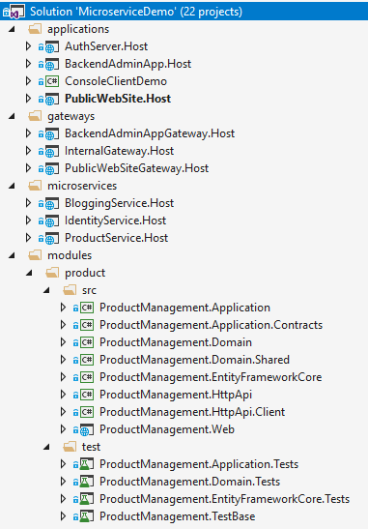
PART – II : THE IMPLEMENTATION Overall Solution
Source code: http://bit.ly/ms-demo-source
Documentation: http://bit.ly/ms-demo-doc

Slide 22
PART – II : THE IMPLEMENTATION Authentication with IdentityServer4
Open source OpenId Connect & OAuth 2.0 server
Main Features
Authentication as a Service
Access Control for APIs
Single sign on / sign out
Grant Types (used in this solution)
Hybrid
Client credentials
Visit https://identityserver.io for more

Slide 23

PART – II : THE IMPLEMENTATION Authentication / Hybrid Flow
Public Web Site (MVC)
Needs authentication
Access token
Authorization code
Token
request
Id Token
Access Token
Public Web Site
Gateway
browser
Access token
Authorization code
validation
Microservices
Redirected
Authentication Server
(Login & Consent UI)

Slide 24
PART – II : THE IMPLEMENTATION Authentication with IdentityServer4
DEMO

Slide 25
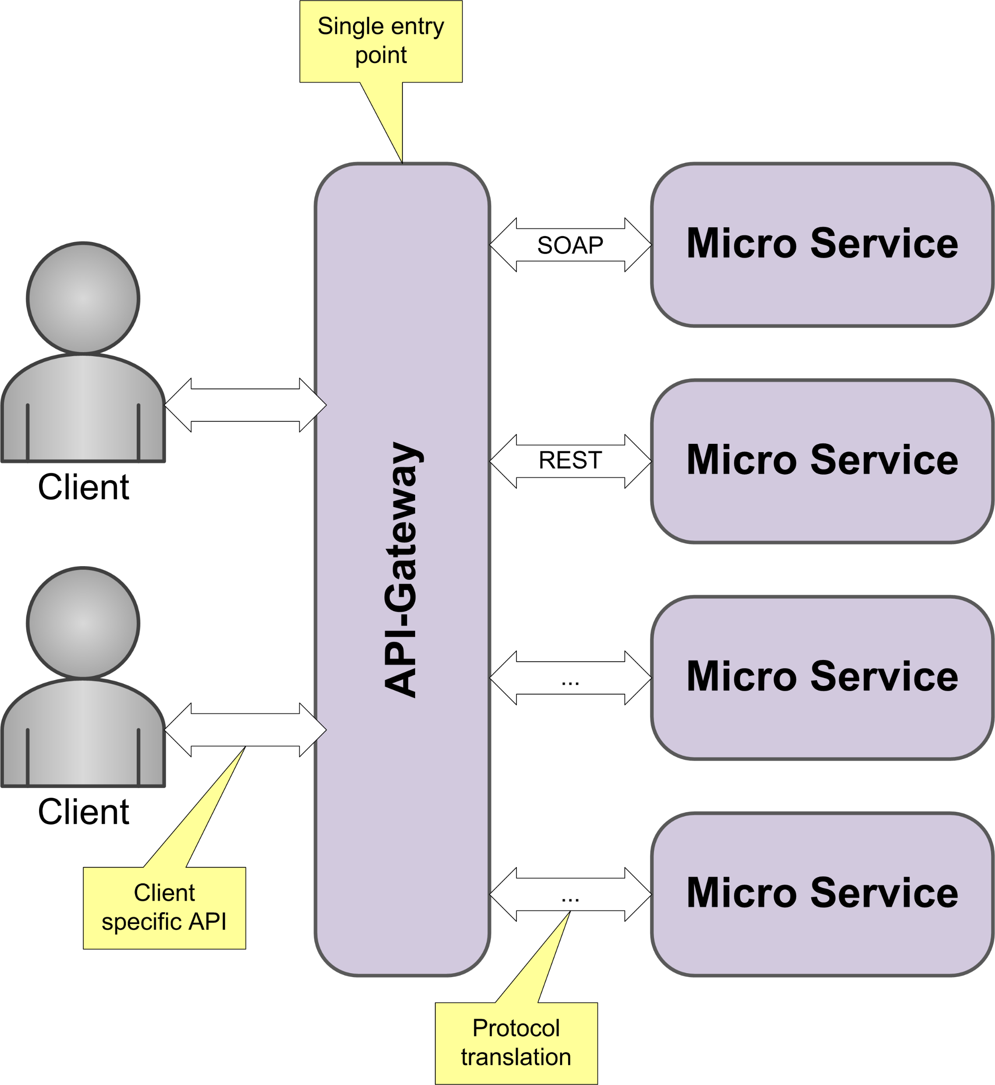
PART – II : THE IMPLEMENTATION API Gateways / Overall
Single entrance point to the system for clients
Can be used as load balancer
Can provide;
Authentication
Rate limiting
Auditing
Routing
Protocol translation
…

Slide 26
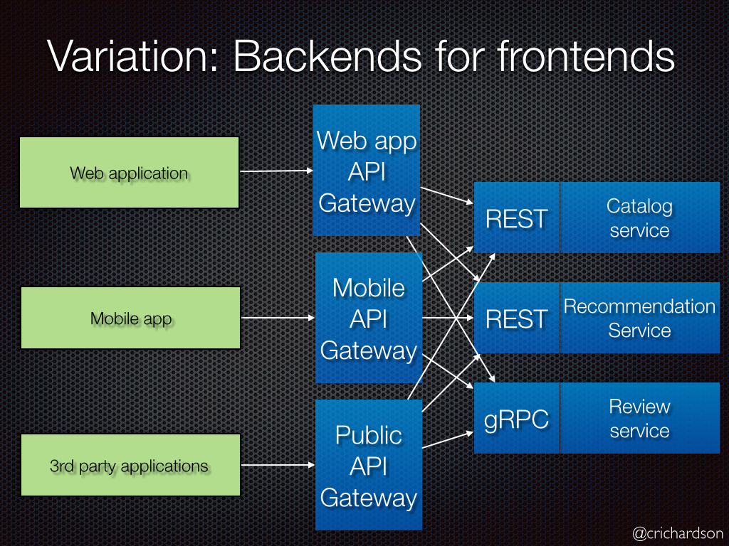
PART – II : THE IMPLEMENTATION API Gateways / Backend For Frontend Pattern
Define a separate API Gateway for each kind of client
Each client may require different set of APIs
Each client may require different level of security, performance, logging, rate limiting, communication protocol… etc.
An Internal API Gateway can be used for inter-microservice communication

Slide 27
PART – II : THE IMPLEMENTATION API Gateways / Ocelot Library
Open souce API Gateway
Routing
Load Balancing
Rate Limiting
Caching
Retry Policies
Authentication & Authorization
Service Discovery with Consul & Eureka
Request Aggregation
…
http://threemammals.com/ocelot

Slide 28
PART – II : THE IMPLEMENTATION Synchronous Communication of Microservices
Protocols: REST, SOAP, GraphQL…
Authenticate over IdentityServer
Always use the Internal Gateway
Temporary network/service downs
Retry policies (for GET, PUT & DELETE)
Working with cached/duplicated data
Fallback logic (like async process/return)
Identity Microservice
Blogging Microservice
Internal Gateway
Product Microservice

Slide 29
PART – II : THE IMPLEMENTATION Dynamic C# API Proxies
Order Microservice
Product Microservice
your code
IProductAppService
ProductController
Dynamic ProductAppService Client Proxy
IProductAppService
REST
(retry)
Http Context
(access_token)
Get auth token
ProductAppService
(Real Implementation)
IProductRepository
IAuthenticator
OAuth
Product DB
Authentication Server

Slide 30
PART – II : THE IMPLEMENTATION Dynamic C# API Proxies
SHOW CODE

Slide 31

PART – II : THE IMPLEMENTATION Asynchronous Communication / Pub-Sub Msg
Publish messages to a topic
Multiple services may subscribe to same topic
Each subscriber gets a copy of each message
Ordered (FIFO) & guaranteed delivery
Messaging applications may not be online at the same time
Publishing Service
Message Broker (topic)
Subscribing Service 1
Subscribing Service 1
Subscribing Service N

Slide 32
PART – II : THE IMPLEMENTATION Asynchronous Communication / Event Bus
ABP Infrastructure
Publish an event
Subscribe to events
Pre-Defined Events
Create, Update & Delete
Identity Microservice
Blogging Microservice
Event Bus
RabbitMQ
Product Microservice

Slide 33
PART – II : THE IMPLEMENTATION Asynchronous Communication / Event Bus
DEMO

Slide 34
PART – II : THE IMPLEMENTATION Data Duplication, Synchronization & Lookup
Requirements
Blogging has a single UserId and needs to other info (Name, Surname, Email…)
REST Call? Can be slow and also leads to a heavy load to the Identity (all services may use it)
Blogging service queries all posts and wants to perform a join in the database for a fast result
REST call is not practical at all
Blogging Microservice
Identity Microservice
Posts Collection
Id
BlogId
Title
Content
CreatorId (UserId)
ReadCount
ViewCount
…
Users Table
Id
UserName
Email
Name
Surname
Password
TwoFactorEnabled
…

Slide 35
PART – II : THE IMPLEMENTATION Data Duplication, Synchronization & Lookup
Create a local users collection with only the fields needed.
Blogging Microservice
Identity Microservice
Posts Collection
Id
BlogId
Title
Content
CreatorId (UserId)
ReadCount
ViewCount
…
BlogUsers Collection
Id
UserName
Email
Name
Surname
Users Table
Id
UserName
Email
Name
Surname
Password
TwoFactorEnabled
…
join

Slide 36
PART – II : THE IMPLEMENTATION Data Duplication, Synchronization & Lookup
Blogging Service
Identity Service
PostService
UserLookupService
REST
UserLookupController
query/Insert/delete
UserSynchronizer
(event handler)
update
IDistributedEventBus
Subscribe & receive
publish
Event Bus
RabbitMQ

Slide 37
PART – II : THE IMPLEMENTATION Service-to-Service Calls / Access Tokens
Authentication Server
Identity Microservice
access
token
Authenticate
(hybrid flow)
Authenticate
(client secret flow)
Blogging Microservice
Internal Gateway
access
token
browser
access
token
Public Web Site
(MVC)
Public Web Site
Gateway
auth
cookie
access
token
access
token
Product Microservice
access
token

Slide 38
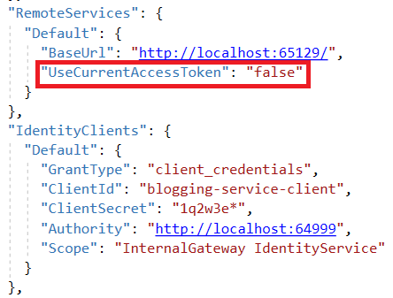
PART – II : THE IMPLEMENTATION Service-to-Service Calls / Access Tokens

Slide 39
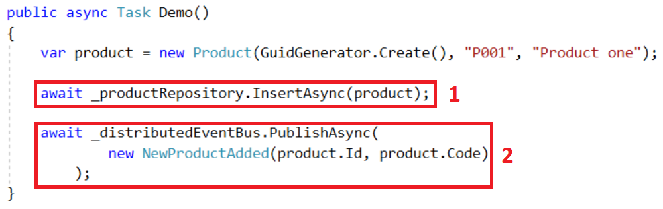
PART – II : THE IMPLEMENTATION Transaction Problem on Publishing Events
Product Microservice
Event Bus
RabbitMQ

Slide 40
PART – II : THE IMPLEMENTATION Transaction Problem on Publishing Events
Solution 1: Use CQRS & Event Sourcing architecture which naturally solves this problem, but it has additional costs.
Solution 2: Use distributed transaction patterns, like Saga.
Solution 3: Save the event to the main database, in the same transaction with the entity insert, then publish the event by a background task.
ProductAppService
Save entity + event
read events
Background Job
Event Bus
publish events
(with retry)
RabbitMQ

Slide 41
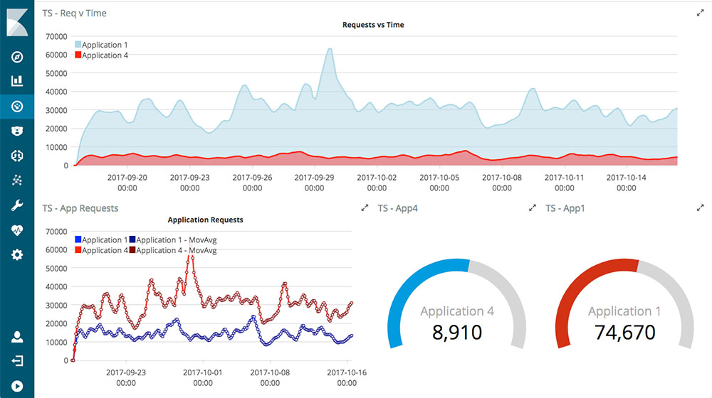
PART – II : THE IMPLEMENTATION Central Logging to Elasticsearch & Kibana UI
Serilog: A powerful dotnet logging library that can write logs to various of destinations including Elasticsearch
Elasticsearch: A distributed, RESTful search and analytics engine
Kibana UI: Visualizer for Elasticsearch data
Service - 1
Service - 2
Web App
Gateway
(Log Database)
(Data Visualization)

Slide 42
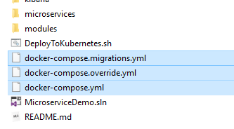
PART – II : THE IMPLEMENTATION Running on Docker Containers
The solution has been configured to run on docker-compose.
Images are published to the Docker Hub: https://hub.docker.com/u/volosoft

Slide 43
Further Learning / Resources
ABP framework https://abp.io
Source code of the demo solution http://bit.ly/ms-demo-source
Documentation of the source code http://bit.ly/ms-demo-doc

Slide 44

Halil İbrahim Kalkan
THANK YOU!
Co Founder
Web: halilibrahimkalkan.com
GitHub: @hikalkan
Twitter: @hibrahimkalkan

Slide 45
Halil İbrahim Kalkan
QUESTIONS?
Co Founder
Web: halilibrahimkalkan.com
GitHub: @hikalkan
Twitter: @hibrahimkalkan

Slide 46
References
https://docs.microsoft.com/en-us/dotnet/standard/microservices-architecture/
https://microservices.io
https://crosp.net/blog/software-architecture/clean-architecture-part-1-databse-vs-domain/

